Slide 1
Accessing Data in Aurelia

Slide 2
HTTP Clients
Aurelia has two plug-ins that can be used to access HTTP services
The aurelia-fetch-client implements the new fetch standard which isn’t entirely complete and not all browsers support
The aurelia-http-client implements the tried and true XMLHttpRequest object
You can find documentation here: http://aurelia.io/docs/plugins/http-services

Slide 3
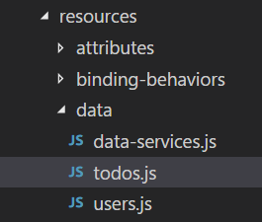
Data Access Organization
Interface Layer
We will organize data access into two layers:
There will separate data object layers for
Users and Todos.
The data services layer is the generic code that interacts with your services
Data Object Layer
Data Services Layer
Create a folder called data in the resources folder and create a file called data-services.js in that folder. Create a users.js and todos.js file.

Slide 4
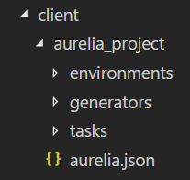
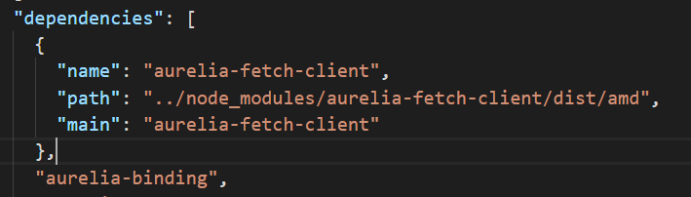
Install the HTTP Client
In the client folder use:
npm install aurelia-fetch-client –s
Open the aurelia.json file and locate the dependencies section and add the configuration for the client as shown below. This tells the bundler to include the aurelia-fetch-client and tells it where to find it.
{
"name": "aurelia-fetch-client",
"path": "../node_modules/aurelia-fetch-client/dist/amd",
"main": "aurelia-fetch-client"
},

Slide 5
Data Services
Include the code shown below in the data-servces.js file
Import and inject the fetch client. Then create the httpClient variable and configure the BASE_URL which is the base URL for you services
import { inject } from 'aurelia-framework';
import {HttpClient, json} from 'aurelia-fetch-client';
@inject(HttpClient)
export class DataServices {
constructor(http) {
this.httpClient = http;
this.BASE_URL = "http://localhost:5000/api/";
}
}

Slide 6
Configure the fetch client
constructor(http) {
this.httpClient = http;
this.BASE_URL = "http://localhost:5000/api/";
this.httpClient.configure(config => {
config
.withBaseUrl(this.BASE_URL)
.withDefaults({
credentials: 'same-origin',
headers: {
'Accept': 'application/json',
'X-Requested-With': 'Fetch'
}
})
.withInterceptor({
request(request) {
console.log(`Requesting ${request.method} ${request.url}`);
return request;
},
response(response) {
console.log(`Received ${response.status} ${response.url}`);
return response;
}
});
});
}
Configure the fetch client.
Add this code to the constructor
Configure the BASE_URL
Set some default headers
Intercepters run when a request is sent or a response is received. These just print some status text to the browser console

Slide 7
GET
The URL will be passed in from the users.js or todos.js objects
The .fetch(url) method creates a promise
When the response comes back from the server we parse the JSON data
Then return to the calling function
The .catch only fires if there is an error in communication, not if there is a database error
get(url) {
return this.httpClient.fetch(url)
.then(response => response.json())
.then(data => {
return data;
})
.catch(error => {
return error;
});
}

Slide 8
POST
The content parameter is JSON formatted data
post(content, url) {
return this.httpClient
.fetch(url, {
method: 'post',
body: json(content)
})
.then(response => response.json())
.then(object => {
return object;
})
.catch(error => {
return error;
});
}
Set the method and bundle the data as JSON

Slide 9
PUT
put(content, url) {
return this.httpClient
.fetch(url, {
method: 'put',
body: json(content)
})
.then(response => response.json())
.then(object => {
return object;
})
.catch(error => {
return error;
});
}

Slide 10
DELETE
delete(url) {
return this.httpClient
.fetch(url, {
method: 'delete'
})
.then(response => response.json())
.then(object => {
return object;
})
.catch(error => {
return error ;
});
}

Slide 11
User Data Object
Import and inject the DataServices
import {inject} from 'aurelia-framework';
import {DataServices} from './data-services';
@inject(DataServices)
export class Users {
constructor(data) {
this.data = data;
this.USER_SERVICE = 'users';
}
}
Set the basic endpoint you use in your services. The fetch client will add this to the BASE_URL

Slide 12
Save a User
user is the data input by the user which is passed to the user data object by the interface layer
serverResponse will be the JSON data returned by the get function in data-services
async save(user){
if(user){
try{
let serverResponse = await this.data.post(user, this.USER_SERVICE);
return serverResponse;
} catch (error) {
console.log(error);
return error;
}
}
}
The async/await construction causes the application to pause until the await statement is resolved

Slide 13
Enable async/await
Install the following module in the client folder:
npm install regenerator-runtime –s
Edit the main.js file to add two lines at the top:
import environment from './environment';
import regeneratorRuntime from 'regenerator-runtime';
window.regeneratorRuntime = regeneratorRuntime;
Regenerator runtime will tanspile code that uses the async/await construction into an older version of JavaScript so more browsers will understand it. Add this code to aurelia.json
{
"name": "regenerator-runtime",
"path": "../node_modules/regenerator-runtime",
"main": "runtime-module"
}

Slide 14
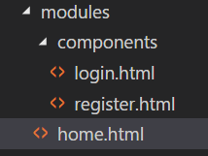
Add a User Registration Form
On the home page we will have a button to log on and a button or link to open
a registration page
To do this we will use a feature of Aurelia called composition
Update the home.html page to this:
<template>
<h1>${message}</h1>
<compose show.bind="showLogin" view="./components/login.html"></compose>
<compose show.bind="!showLogin" view="./components/register.html"></compose>
</template>
<compose> loads a file and inserts it into the html. The show.bind=“” will show or hide the element depending on the value of showLogin which is a Boolean variable we will create in home.js
Create the two files in the components folder

Slide 15
Update login.html
Add the login button and a link for the registration page in the login.html file
click.trigger=“showRegister()” will cause the showRegister() function to execute when the click event occurs on the span.
<template>
<button click.trigger="login()">Login</button>
<span class="registerLink" click.trigger="showRegister()">Register</span>
</template>

Slide 16
Update register.html
Add the following code to register.html
<template>
<button click.trigger="save()">Save</button>
</template>
The only thing we’re doing at this point is providing a way to return to the login.html view.

Slide 17
Update the home.js file
@inject(Router)
export class Home {
constructor(router) {
this.router = router;
this.message = 'Home';
this.showLogin = true;
}
login(){
this.router.navigate('list');
}
showRegister(){
this.showLogin = false;
}
save(){
this.showLogin = true
}
}

Slide 18
Add the Form to register.html
<template>
First Name: <input value.bind="user.firstName">
Last Name: <input value.bind="user.lastName">
Email: <input value.bind="user.email">
Password: <input value.bind="user.password">
<button click.trigger="save()">Save</button>
</template>

Slide 19
Update home.js
Import and inject the user data object
import {inject} from 'aurelia-framework';
import {Router} from 'aurelia-router';
import { Users } from '../resources/data/users';
@inject(Router, Users )
export class Home {
constructor(router, users) {
this.router = router;
this.users = users;
this.message = 'Home';
this.showLogin = true;
}
…

Slide 20
Update home.js
showRegister(){
this.user = {
firstName: "",
lastName: "",
email: "",
password: ""
}
this.registerError = "";
this.showLogin = false;
}
async save() {
let serverResponse = await this.users.save(this.user);
if (!serverResponse.error) {
this.showLogin = true;
} else {
this.registerError = "There was a problem registering the user."
}
}

Slide 21
CORS
Browsers don’t allow pages to initiate requests to domains that are different
from the domain of the web page.
localhost:9000
localhost:5000
http://localhost:5000/api/users
Index.html
This is called a cross-domain request and not allowed for security reasons
To allow this we can have the server add a header which tells the browser that the cross-domain request is trusted.

Slide 22

CORS
Install the following module in your server folder:
npm install cors –s
Add this to your express.js file:
var cors = require('cors');
module.exports = function (app, config) {
app.use(cors({origin: 'http://localhost:9000'}));

Slide 23
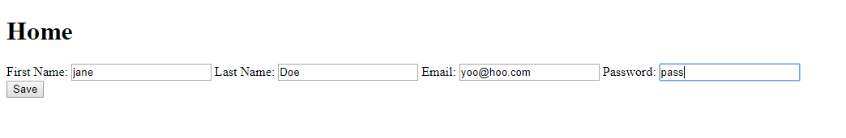
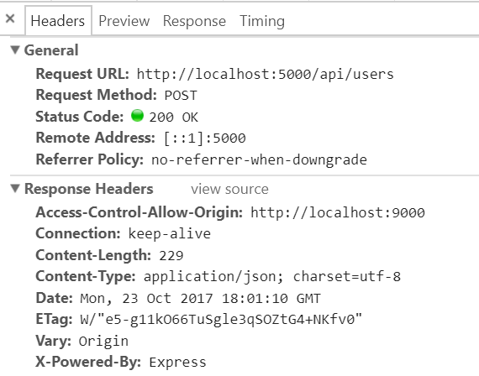
Try it!

